Slide 1
Software Engineering
Topic 3:
Software Engineering Principles
Your Name: _____________________
Computer Science & Engineering Department
The Chinese University of Hong Kong

Slide 2
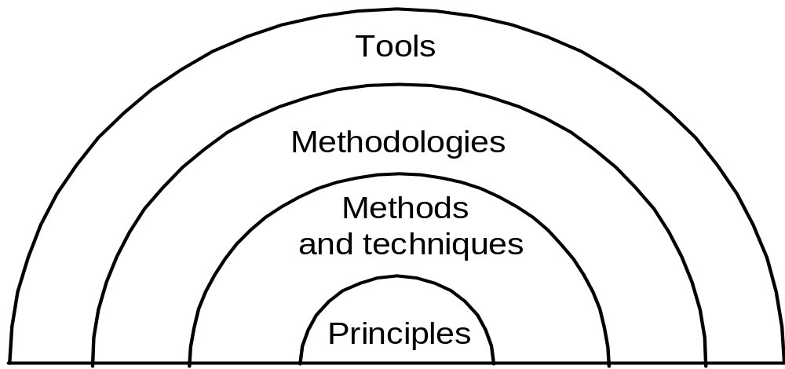
Software Engineering Principles
Process, Metrics & Management
Topic 4: Spec
Topic 5: Design
Topic 6: Test & Verification
Topic 3:
Figure 3.1: Contents of various topics
Notes:
Figure 3.1 shows the relationship between principles, methods and techniques, methodologies, and tools, which are the core in Software Engineering. Each layer in the figure is based on the layer(s) below it and is more susceptible to change, due to the passage of time. The figure shows clearly that principles are the basis of all methods, techniques, methodologies, and tools.
This figure can also be used to explain the structure of this course. In this topic, Topic 3, we present essential software engineering principles. In Topics 4, 5, and 6, we examine methods and techniques based on the principles of the current topic. Other issues relating to methodologies, tools and environments will be addressed in tutorials and the project.
Note that we distinguish between methods and techniques. Methods are general guidelines that govern the execution of some activity; they are rigorous, systematic, and disciplined approaches. Techniques are more technical and mechanical than methods; often, they also have more restricted applicability. In general, however, the difference between the two is not sharp. We will therefore use the two terms interchangeably.
Sometimes, methods and techniques are packaged together to form a methodology. The purpose of a methodology is to promote a certain approach to solving a problem by preselecting the methods and techniques to be used. Tools, in turn, are developed to support the application of techniques, methods, and methodologies.

Slide 3
Software Engineering Principles
Inner layers are more __general__ and abstract
  Focus of lectures
Outer layes are more _concrete_ but likely to ___change__ with time
  Focus of tutorials for the project
S/W eng. principles are more likely to remain unchanged. They are driven by reliability (dependability), evolvability, and maintainability as quality requirements
Notes:
In examining the previous figure, Inner layers are more general and abstract. They are the focus of lectures.
Outer layers are more concrete but likely to change with time. They are the focus of tutorials and the project.
Software engineering principles are more likely to remain unchanged. They are driven by software quality requirements, such as reliability (dependability), evolvability, and maintainability, and so on.

Slide 4
Software Engineering Principles
Rigor and Formality
Separation of Concerns
Modularity
Abstraction
Anticipation of Change
Generality
Incrementality
Notes:
In this topic, we discuss seven general and important principles that apply throughout the software development process: rigor and formality, separation of concerns, modularity, abstraction, anticipation of change, generality, and incrementality.
The list, by its very nature, cannot be exhaustive, but it does cover the important areas of software engineering. Although the principles often appear to be strongly related, we prefer to describe each of them separately in quite general terms.

Slide 5
(1) Rigor and Formality
Software development is a creative activity.
Rigor complements, but not constrains, creativity
The highest degree of rigor is called formality
__rigor_
_formality_
Notes:
Software development is a creative activity. In any creative process, there is an inherent tendency to be neither precise nor accurate, but rather to follow the inspiration of the moment in an unstructured manner. That is, it may need to allow flexibility and tolerate uncertainty. Rigor, on the other hand, means strict precision and exactness, which is required for science and engineering. Rigor complements but not constrains creativity. It enhances creativity by improving the engineer’s confidence in creative results, once they are critically analyzed in the light of a rigorous assessment.
The highest degree of rigor is called formality. So rigor includes formality. A rigorous software is not necessary formal, but a form software is certainly rigorous. Whenever possible, we should pursue formality in software engineering.
Rigor and formality are not restricted to programming. They should be applied throughout the software process. Topic 4 describes rigorous and formal approaches to software specification. Topic 5 shows these concepts in action in the case of software design. Topic 6 does the same for software verification. So far, our discussion has emphasized the influence of rigor and formality on the reliability and verifiability of software products.
Rigor and formality also have beneficial effects on maintainability, reusability, portability, understandability, and interoperability. For example, rigorous, or even formal, software documentation can improve all of these qualities over informal documentation, which is often ambiguous, inconsistent, and incomplete.

Slide 6
(1) Rigor and Formality
Engineering design processes are formed by methods and techniques which are either rigorous or formal
The advantage of formality over rigor is that formality maybe the basis of __automation__ of the process
the most formal phase in s/w engineering:
_implementation_
Notes:
In every engineering field, the design process proceeds as a sequence of well-defined, precisely stated, and supposedly sound steps. In each step, the engineer follows some methods or applies some techniques. The methods and techniques applied may be based on some combination of theoretical results derived by some formal modeling of reality, empirical adjustments that take care of phenomena not dealt with by the model, and rules of thumb that depend on past experience.
The blend of these factors results in a rigorous and systematic approach, the “methodology” that can be easily explained and applied time and again.
The description of what a program does may be given in a rigorous way by using natural language; it can also be given formally by providing a formal description in a language of logical statements. The advantage of formality over rigor is that formality may be the basis of automation of the process. For instance, one may hope to use the formal description of the program to create the program (if the program does not exist yet) or to show that the program corresponds to the formal description (if the program and its formal specification exist).
Traditionally, there is only one phase of software development where a formal approach is used: programming. In fact, programs are formal objects: They are written in a language whose syntax and semantics are fully defined. Programs are formal descriptions that may be automatically manipulated by compilers: They are checked for formal correctness, transformed into an equivalent form in another language (assembly or machine language), “pretty-printed” so as to improve their appearance, etc. These mechanical operations, which are made possible by the use of formality in programming, can improve the reliability and verifiability of software products.

Slide 7
(1) Rigor and Formality
rigor and formality improve reliability, verifiability, maintainability, reusability, portability, understandability and interoperability => _product_ oriented
rigor and formality applied to s/w _process_ helps in reusability, maintainability, evolvability, timeliness and productivity

Slide 8
(2) Separation of Concerns
Allows us to deal with different individual aspects of a problem for concentration
The major way to master the _complexity_ of a large-scale project
Separation of concerns could be achieved in terms of
  time (time to code and time to test)
  qualities (correctness vs. efficiency)
  views (data flow vs. control flow)
  parts (modularity)
Notes:
Separation of concerns allows us to deal with different aspects of a problem, so that we can concentrate on each individually. Separation of concerns is a commonsense practice that we try to follow in our everyday life to overcome the difficulties we encounter. The principle should be applied also in software development, to master its inherent complexity.
There are various ways in which concerns may be separated. First, one can separate them in time. As an everyday example, a university professor might apply separation of concerns by scheduling teaching-related activities such as holding classes, seminars, office hours, and department meetings from 9 A.M. to 2 PM, Monday through Thursday; consulting on Friday; and engaging in research the rest of the time. Such temporal separation of concerns allows for the precise planning of activities and eliminates overhead that would arise through switching from one activity to another in an unconstrained way. Separation of concerns in terms of time is the underlying motivation of the software life cycle models, each of which defines a sequence of activities that should be followed in software production.
So we can separate software development in terms time, such as the time to write code and the time to test the written code. The software development phases are essentially separated by time.
We can also separate the concerns of software quality regarding correctness/reliability vs. efficiency. Software development can aim to produce working software first, then improve its efficiency. For example, when a sorting routine is needed in the software, we can implement a simple sorting algorithm first, such as bubble sort, which is simple to implement. Once the implementation works, then we can replace it with a more complicated yet highly efficient sorting algorithm, such as quick sort.
We can also separate the concerns on different views of the software. In software design, for example, we can have data flow view vs. control flow view of the software. In Topic 5, we will address this design aspect in more detail.
Finally a nature way to separate a software system to separate it by parts, such as different modules. Different modules then can be assigned to different software engineers for development. This idea is so important that we will make it a separate software engineering principle called modularity.

Slide 9
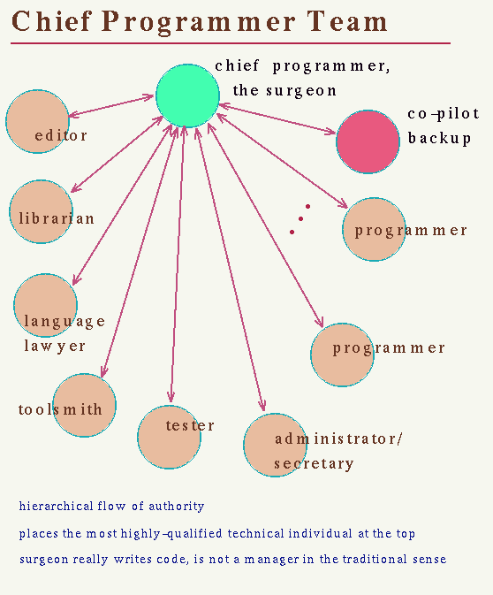
(2) Separation of Concerns
product concerns vs process concerns
make some overall design decisions first
  Functional correctness vs performance
separation of concerns leads to separation
  of responsibility for large projects
  Options:
    (1) Separate development process roles:
    architect + designer + programmer + tester
    (2) Separate functionalities:
    module A, B, C, …
    (3) Separate obligations:
    “Chief-programmer team”
Notes:
More specifically, there are many decisions that must be made in the development of a software product. Some of them concern features of the product: functions to offer, expected reliability, efficiency with respect to space and time, the product’s relationship with the environment (i.e., the special hardware or software resources required), user interfaces, etc. Others concern the development process: the development environment, the organization and structure of teams; scheduling, control procedures, design strategies, error recovery mechanisms, etc. Still others concern economic and financial matters. These different decisions may be unrelated to one another. In such a case, it is obvious that they should be treated separately.
Separation of concerns leads to separation of responsibility for large projects.
The options include separating development process roles, such as software architect, designer, programmer, and tester. Each of them has his or her responsibility.
Another option is separate functionalities, such as dividing a large project into separate modules, and assign them to various teammates. This is probably the way you will handle your class project.
We can also separate obligations for large software project, so that some leading roles may be clearly identified. “Chief-programmer team” is an example, where a “chief” leader take up the role in leading the project, like the surgeon in surgical team.
The choice of these options depend on the scale and nature of the project. Most industrial organization use option (1). Your project may choose option (2), as your project is still relatively small in scale, and most people may want equal share of the duty. The option (3) can be useful in exploratory projects where experts take larger responsibility. In this case, however, the chief programmer will need a lot of support, as he or she is the center of the project.

Slide 10
(3) Modularity
A complex system may be divided into simpler pieces called modules (units); such a system becomes modular
Modularity allows separation of concern applied to two phases:
Intra-modular phase
Inter-modular phase
__Bottom-up__ design/implementation
__Top-down___ design/implementation
Notes:
A complex system may be divided into simpler pieces called modules, or units. A system that is composed of modules is called modular: The main benefit of modularity is that it allows the principle of separation of concerns to be applied in two phases: when dealing with the details of each module in isolation (and ignoring details of other modules) and when dealing with the overall characteristics of all modules and their relationships in order to integrate them into a coherent system.
If the two phases are executed in sequence first by concentrating on modules and then on their composition, then we say that the system is designed or implemented bottom up; the converse when we decompose modules first and then concentrate on individual module design is top-down design or implementation.

Slide 11
(3) Modularity
Three goals of modularity:
  decomposability: “divide and conquer”
  composability
    Top-down, bottom-up
    A popular approach: __top-down_ design + _bottom-up_ implementation
  capability of understanding
Notes:
Modularity is an important property of most engineering processes and products. For example, in the automobile industry, the construction of cars proceeds by assembling building blocks that are designed and built separately. Furthermore, parts are often reused from model to model, perhaps after minor changes. Most industrial processes are essentially modular, made out of work packages that are combined in simple ways (sequentially or overlapping) to achieve the desired result.
There are three goals of modularity: decomposability, composability, and capability of understanding.
The decomposability of a system is based on dividing the original problem top down into subproblems and then applying the decomposition to each subproblem recursively. This is based on a popular divide and conquer strategy in handling complex systems: divide and isolate them first, and conquer them individually.
The composability of a system is based on starting bottom up from elementary components and proceeding to the finished system.
Decomposability and composability of a software system enable two techniques for the development of the system: top-down and bottom-up, which can be employed in design phase as well as implementation phase.
A popular approach is to employ top-down design, and bottom-up implementation.
The capability of understanding each part of a system separately aids in modifying a system for evolutionary nature of software.

Slide 12
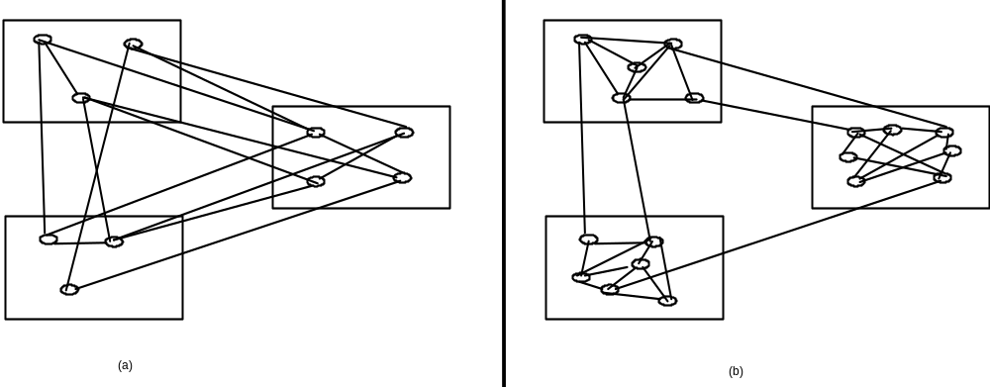
(3) Modularity
Key: high cohesion and low coupling
  cohesion: internal connections in a module
  coupling: external connections among modules
cohesion
Figure 3.2: Cohesion and coupling
coupling
_____ cohesion
_____ coupling
_____ cohesion
_____ coupling
Notes:
The key design issue for modularity is to achieve high cohesion and low coupling of software modules, where cohesion is the internal connections in a module, and coupling is the external connections among modules.
Each module should be highly cohesive: module understandable as a meaningful unit; components of a module are closely related to one another.
Modules should exhibit low coupling: modules have low interactions with others. In this way each module can be more understandable separately.
The two diagrams shown in this slide represent two designs from the same system. They have the same complexity and they use the same number of modules. However, the left design shows low cohesion and high coupling, while the right design shows high cohesion and low coupling. The right one is better.

Slide 13
(4) Abstraction
identification of the important aspects of a phenomenon
a special case of ___separation of concern__
separate
Important aspects
unimportant details
Notes:
Abstraction is a fundamental technique for understanding and analyzing complex problems. In applying abstraction, we identify the important aspects of a phenomenon and ignore its details. Thus, abstraction is a special case of separation of concerns wherein we separate the concern of the-important aspects from the concern of the less important details.
The type of abstraction to apply depends on purpose
Example: the user interface of a watch (its buttons) abstracts from the watch's internals for the purpose of setting time; other abstractions needed to support repair

Slide 14
(4) Abstraction
mathematical formulas and equations are abstraction of reality, e.g. __E=mc^2__
programs are abstractions build on top of h/w
abstraction applies to s/w processes as well as s/w products
  E.g. cost estimation: using key factors of the new system
  E.g. comments on the header of program files
Notes:
Abstraction Example: equations describing complex circuit (e.g., amplifier) allows designer to reason about signal amplification.
Equations may approximate description, ignoring details that yield negligible effects (e.g., connectors assumed to be ideal).
Programs are abstractions built on top of hardware, as programs contain instructions to move data in memory and disk.
Abstraction yields models
For example, when requirements are analyzed we produce a model of the proposed application
The model can be a formal or semiformal description
Abstraction in process
When we do cost estimation we only take some key factors into account. We apply similarity with previous systems, ignoring detail differences.
Comments on the header of program files provide abstraction about the programs, regarding their implementation detail.

Slide 15
(5) Anticipation of Change
anticipate how and where the changes are likely to occur
- Year 2000 problem (Y2K problem)
- IPv4 problem
Q: How many bits are used in IPv4 for IP address? A:32 bits
anticipation of change is the basis for _modularization_ strategy in software design
to improve evolvability, maintainability, reusability
Notes:
The ability of software to evolve does not happen by accident or out of sheer luck. It requires a special effort to anticipate how and where changes are likely to occur. Designers can try to identify likely future changes and take special care to make these changes easy to apply. Historically, here are many famous software evolution problems due to lack of anticipation of change.
We shall see this important point in action in Topic 5 in the case of design. In that topic, we show how software can be designed such that likely changes that we anticipate in the requirements, or modifications that are planned as part of the design strategy may be incorporated into the application smoothly and safely.
Basically, likely changes should be isolated in specific portions of the software in such a way that changes will be restricted to such small portions. In other words, anticipation of change is the basis for modularization strategy in software design.
Ability to support software evolution requires anticipating potential future changes. It is the basis to improve software evolvability, as well as maintainability and reusability.

Slide 16
(5) Anticipation of Change
it is the principle that distinguishes s/w the most
it requires appropriate process and tools
  Configuration Management ( CM )
applied to s/w process and product
  Change of personnel
  Project cut
  Maintenance needs
Notes:
Anticipation of change is perhaps the one principle that distinguishes software the most from other types of industrial productions. In many cases, a software application is developed when its requirements are not entirely understood.
Then, after being released, on the basis of feedback from the users, the application must evolve as new requirements are discovered or old requirements are updated. In addition, applications are often embedded in an environment, such as an organizational structure. The environment is affected by the introduction of the application, and this generates new requirements that were not known initially.
Therefore, it requires appropriate process and tools to handle the constant changes in software development. Configuration Management (CM) is a process for developing and maintaining software in a desired, consistent state. It’s a way to make sure that a system performs as it is expected to as changes are made over time.

Slide 17
(6) Generality
a generalized problem might be simpler, more reusable, than the original problem.
the solutions tend to be more available
more costly (time, resource)
generality is a fundamental principle of many commercial tools and packages (e.g. spread sheets, databases, word processors)
a trend for s/w products
  total features [Microsoft: Excel, Access, Word]
  integrated capabilities [Apple: iPod, iPhone, iPad by iTune]
  complete solutions [Amazon: AWS cloud computing]
Notes:
A generalized problem might be simpler, more reusable, than the original problem, as it does not need too much specialization.
Also the solutions tend to be more available. . Some off-the-shelf package may already provide the solutions.
A generalized solution may be more costly, in terms of speed of execution, memory requirements, or development time, than the specialized solution that is tailored to the original problem. Thus, it is necessary to evaluate the trade-offs of generality with respect to cost and efficiency, in order to decide whether it is worthwhile to solve the generalized problem instead of the original problem.
For example, suppose you are asked to merge two sorted sequential files into one. On the basis of the requirements, you know that the two source files do not contain any records with identical key values. Clearly, then, if you generalize your solution to accept source files that may contain different elements with the same key value, you provide a program that has a higher "potential” for reusability. Also, you may be able to use a merge program that is available in your system library.
While solving a problem, try to discover if it is an instance of a more general problem whose solution can be reused in other cases. Sometimes a general problem is easier to solve than a special case. You need to carefully balance generality against performance and cost.
Generality is a fundamental principle of many commercial tools and packages (e.g. spread sheets, databases, word processors)
It is a trend for s/w products, which include some aspects, such as
total features, such as the Microsoft’s products of Excel, Access and Word, which provide general features users need.
integrated capabilities, where software can seamlessly run on different devices with different capabilities.
complete solutions as provided by cloud computing, where Amazon AWS is an example. Software can be generally provided as a cloud service.

Slide 18
(7) Incrementality
it characterizes an evolutionary process that proceeds in a stepwise fashion, in increments
to develop useful early subsets first for early feedback
it is intertwined (twisted together) with
_______________________________
Notes:
Incrementality characterizes a process that proceeds in a stepwise fashion, in increments. We try to achieve the desired goal by successively closer approximations to it. Each approximation is an increment over the previous one. Incrementality applies to many engineering activities. When applied to software, it means that the desired application is produced as a result of an evolutionary process.
One way of applying the incrementality principle consists of identifying useful early subsets of an application that may be developed and delivered to customers, in order to get early feedback. This allows the application to evolve in a controlled manner in cases where the initial requirements are not stable or fully understood. The motivation for incrementality is that in most practical cases there is no way of getting all the requirements right before an application is developed. Rather, requirements emerge as the application, or parts of it is available for practical experimentation.
Consequently, the sooner we can receive feedback from the customer concerning the usefulness of the application, the easier it is to incorporate the required changes into the product. Thus, incrementality is intertwined with anticipation of change and is one of the cornerstones upon which evolvability may be based. Many commercial software products evolve through a series of versions incrementally.

Slide 19
(7) Incrementality
incrementality applies to improve many s/w qualities
intermediate stages of an incrementally designed product are called _prototypes__, i.e., _approximations_ of the end product
  rapid prototyping (vs. Waterfall model)
Notes:
Incrementality applies to improve many software qualities. We may progressively add functions to the application being developed, starting from a kernel of functions and gradually complete the rest. We can also add performance in an incremental fashion, where initial version emphasizes reliability and user interface, while space and time efficiency can be improved later.
When an application is developed incrementally, intermediate stages of an incrementally designed product are called prototypes of the end product; that is, they are just approximations of the end product. The idea of rapid prototyping is often advocated as a way of progressively developing an application hand in hand with an understanding of its requirements.
Obviously, a software life cycle based on rapid prototyping is rather different from the typical waterfall model described earlier, wherein we first do a complete requirements analysis and specification and then start developing the application, Instead, prototyping is based on a more flexible and iterative development model. This difference affects not only the technical aspects of projects, but also the organizational and managerial issues.

Slide 20




Rapid Prototyping Converges on the End Result
Notes:
We use a simple illustration for rapid prototyping, showing how it converges on the end result.

Slide 21
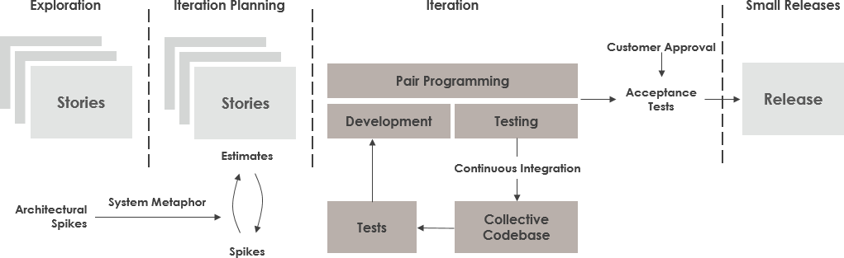
Extreme Programming (XP) Process
Notes:
Extreme programming (XP) is a software development methodology which is intended to improve software quality and responsiveness to changing customer requirements. As a type of agile software development, it advocates frequent "releases" in short development cycles, which is intended to provide quick response, better adaptivity, and improve productivity. It introduces checkpoints at which new customer requirements can be adopted.
Other elements of extreme programming include: programming in pairs or doing extensive code review, unit testing of all code, not programming features until they are actually needed, a flat management structure, code simplicity and clarity, expecting changes in the customer's requirements as time passes and the problem is better understood, and frequent communication with the customer and among programmers. The methodology takes its name from the idea that the beneficial elements of traditional software engineering practices are taken to "extreme" levels. As an example, code reviews are considered a beneficial practice; taken to the extreme, code can be reviewed continuously, i.e. the practice of pair programming.

Slide 22
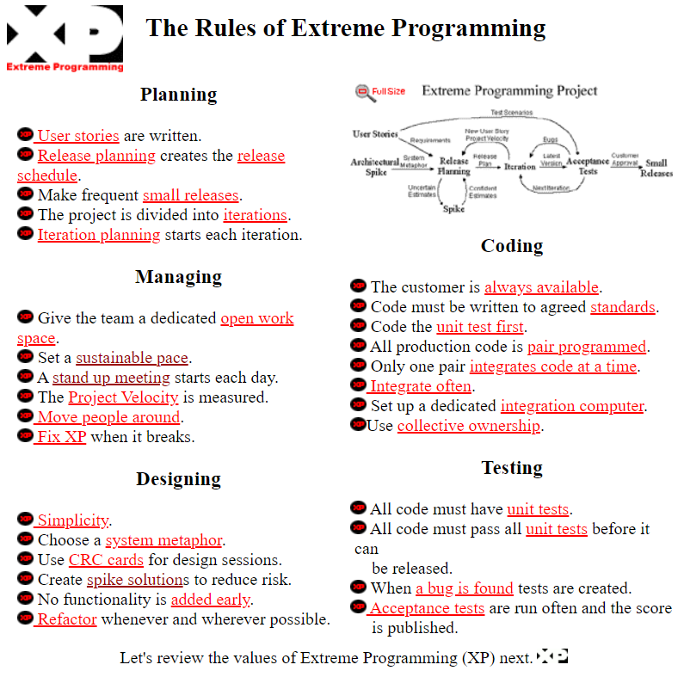
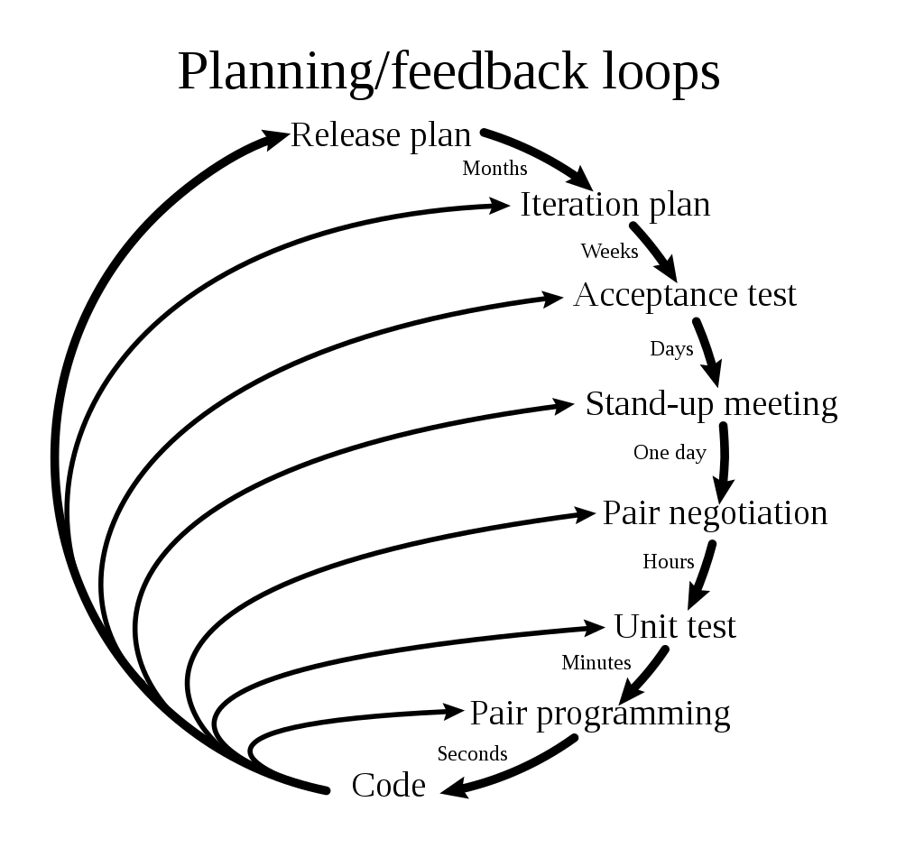
Notes:
This slide shows the rules of Extreme Programming, and Planning/Feedback Loops in various activities.
Rules
The first version of rules for XP was published in 1999 by Don Wells at the XP website. 29 rules are given in the categories of planning, managing, designing, coding, and testing. Planning, managing and designing are called out explicitly to counter claims that XP doesn't support those activities.
Another version of XP rules was proposed by Ken Auer in XP/Agile Universe 2003. He felt XP was defined by its rules, not its practices (which are subject to more variation and ambiguity). He defined two categories: "Rules of Engagement" which dictate the environment in which software development can take place effectively, and "Rules of Play" which define the minute-by-minute activities and rules within the framework of the Rules of Engagement.
Feedback
Within extreme programming, feedback relates to different dimensions of the system development:
Feedback from the system: by writing unit tests or running periodic integration tests, the programmers have direct feedback from the state of the system after implementing changes.
Feedback from the customer: The functional tests (aka acceptance tests) are written by the customer and the testers. They will get concrete feedback about the current state of their system. This review is planned once in every two or three weeks so the customer can easily steer the development.
Feedback from the team: When customers come up with new requirements in the planning game the team directly gives an estimation of the time that it will take to implement.
Feedback is closely related to communication and simplicity. Flaws in the system are easily communicated by writing a unit test that proves a certain piece of code will break. The direct feedback from the system tells programmers to recode this part. A customer is able to test the system periodically according to the functional requirements, known as user stories. To quote Kent Beck, "Optimism is an occupational hazard of programming. Feedback is the treatment."

Slide 23
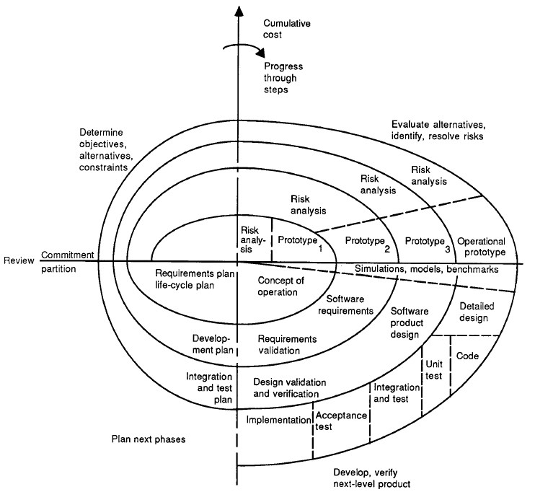
The Spiral Software Process Model
Figure 3.3: The Spiral Model
Notes:
The spiral model is a software development process combining elements of both design and prototyping-in-stages, in an effort to combine advantages of top-down and bottom-up concepts. Also known as the spiral lifecycle model (or spiral development), it is a systems development method (SDM) used in information technology (IT). This model of development combines the features of the prototyping and the waterfall model. The spiral model is intended for large, expensive and complicated projects.

Slide 24
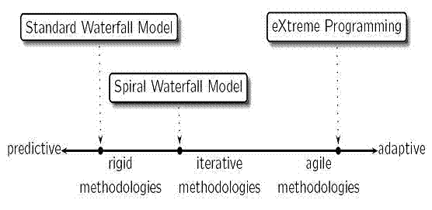
Software Development Process Comparison
Notes:
This diagram shows the spectrum of the three induced software development process models: standard waterfall model, extreme programming model, and spiral waterfall model. Toward the left hand side, the model is more rigid thus more predictive; toward the right hand side, the model is more agile thus more adaptive. The spiral waterfall model is intended to combine both side techniques with an iterative approach.

Slide 25
Topic 3 Conclusion
Seven software engineering principles:
  Rigor and formality
  Separation of concerns
  Modularity
  Abstraction
  Anticipation of change
  Generality
  Incrementality
Applicable to all software engineering phases
There are various software development processes; key phases are specification, design, and testing
Notes:
This slide summarizes what we have learned in Topic 3.
It important to know the seven software engineering principles:
Rigor and formality
Separation of concerns
Modularity
Abstraction
Anticipation of change
Generality
Incrementality
They are applicable to all software engineering phases
The software engineering principles are the basis for the set of methods and techniques in the following three key phases: specification, design, and testing, which will be described in the remainder of this course.

